Slide 1
World Bank Procurement Framework
Value for Money, Integrity, Sustainable Development
Coming in 2016

Slide 2
Agenda
Good to know
The journey to here
Feedbacks from stakeholders
      Bank’s Approach
      Board Agreement (key topics)
Key change of traditional procurement (consulting services)
The Reform in one-shot
Conclusions

Slide 3
Good to know:
Bank funds over 1,800 investment projects in 172 countries
Procurement portfolio worth about US$44 Billion
New Procurement Framework is based on feedback from 5,000 people around the World

Slide 4
The journey to here
Initiating Discussion Paper 2012
Check that the Bank’s approach is modern, meets new needs & futureproof
Global consultations (round 1)
Proposed New Framework 2013
What we heard in consultations
Board debate & direction given
Developing the New Framework 2014
Proposals to resolve Complex issues
Global consultations (Round 2)
Finalizing the New Framework 2015
Finalized Policy and approaches to complex issues
Board approval to implement in FY16
Respond positively to issues raised by stakeholders, even when difficult

Slide 5
Stakeholders told us:
Robust set of principles, reflecting new concepts in public procurement
Procurement methods that are context-specific, proportional, and best fit for purpose
Greater use of clients’ procurement arrangements and institutions
More support for capacity building
Use of e-procurement to get better data and metrics
Special attention to FCS and small economies

Slide 6
Stakeholders told us:
Take a more strategic approach informed by up-front analysis of markets, industry practices, and competition.
Cover the full procurement cycle, from design through planning, tendering, contract execution, and completion.
New thinking needed about the Bank’s approach to fraud and corruption
Focus most on the largest, most complex, and most innovative contracts
Set metrics to measure results on the ground.

Slide 7
Bank’s Approach:
Identified proposals to address feedback
Examined contemporary procurement practice to ensure Bank is up to date
Identified and exposed areas of disagreement to drive decisions/action
Continuous Board level engagement to resolve complex policy issues
Used PP&F to empower management to make faster decisions and adapt Framework as needed

Slide 8
Board agreement on complex issues:
Increase support to country capacity building and institutional strengthening (GGP, MDTF etc.)
More choices, reflecting different situations and contexts and options for tailored procurement approaches: Fit-for-purpose.
Encourages the use of VfM decision-making for award decisions to determine most advantageous bid/proposal (LECB or rated)
Supports innovation, e.g. competitive dialogue, BAFO, negotiation, more options for PPPs

Slide 9
Board agreement on complex issues:
Enables delegation to other procurement arrangements. Alternative procurement arrangements (APA) may be used in clearly defined circumstances (MDB’s, Bilaterals, Borrowers)
Enables tracking and disclosure of procurement data, setting benchmarks and metrics (STEP)
Options for hands-on expanded implementation support from Bank staff
Streamlines Bank’s prior reviews while enhancing other Banks’s fiduciary approaches

Slide 10
Board agreement on complex issues:
Integrity will be strengthened, ACG’s and Sanctions continue to apply
If Borrower requests, sustainable procurement criteria may be applied
Streamline to 9, Bank’s requirements for National Procurement
Provide more support to contract management (start with procurements > OPRC, use KPI’s, monitoring and reporting)

Slide 11
Board agreement on complex issues:
Significantly enhance our approach to procurement-related complaints (up to award) e.g. standstills, response times etc.
Continue international advertising and use of SBD’s above country thresholds, unless an APA is agreed
Establish an external sectoral engagement program
Empowers management to be flexible while following Core Principles, from equivalence to consistency
Create a training and development program for Bank staff (and others) to support new Framework, reassess skills FY17

Slide 12
Key changes in traditional procurement: Consulting services (example)
Require complete TOR issued with selection documents
Adjusted number of short-listed firms 5-8
Eliminated shortlist restrictions: Fit for purpose, not prescriptive, removed geographic constraints.
7-days “pause” between the notification of the technical score and the opening of the financial proposals

Slide 13
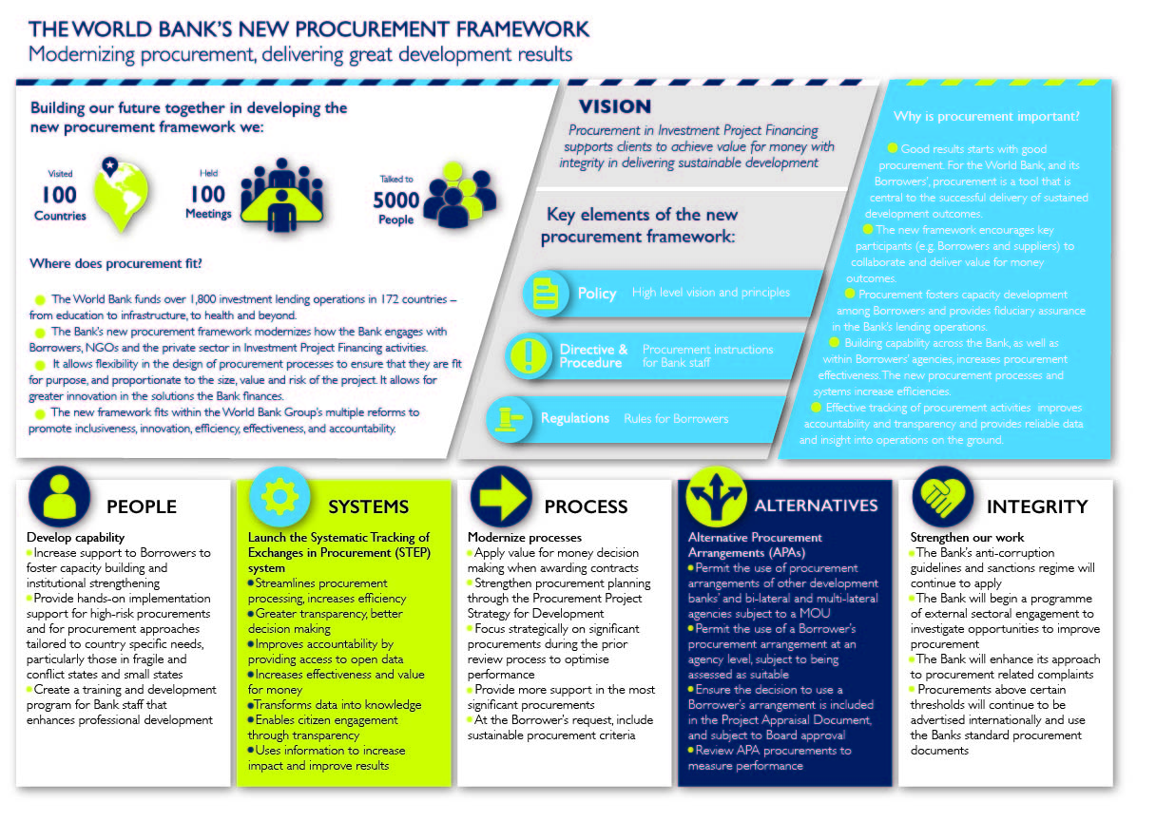
The

Slide 14
Conclusion
  Cited as best practice example of policy development for the entire Bank
Four year journey to date
Responded positively to stakeholder issues
Our reform is most progressive of any MDB
Effectiveness planned April 2016
    New Project Concept Notes
  Program of communications, training, mentorship etc.
  Work together, adapt as needed, be successful

Slide 15
World Bank Procurement Framework
Value for Money, Integrity, Sustainable Development
Coming in 2016

Slide 16

STEP
Portfolio Monitoring
Procurement Planning
Activity Tracking
Reporting and Analytics
Transparency
Performance
Risk
Approach to market
System Integration
Open Contracting
Systematic Tracking of Exchanges in Procurement

Slide 17

STEP – Value Proposition
Life cycle tracking
Risk identification
Integrity scanning
Bidding information
Transparency
Legacy integration
Monitoring & reporting
Records all contracts
Tracks all performance
Identifies risks at activity level
Helps inform PRAMS and SORT
Verifies supplier eligibility
Reduces risk of ineligible payments
Captures competition data
Facilitates market analysis
Automates publication of data
Enables open contracting
Migrates SEPA, PROCYS, ENO
Staging are for client systems
Simplifies access to data
Enhances analytics

Slide 18
STEP – System Outputs
Performance Data
Task Management
Risk Identification
Market Intelligence
Process delays by the Client
Review delays by the Bank
(TTL, Procurement, Review Level)
Portfolio: All Projects
Project: All Procurement Plans
Activity: All bid activities
Activity level risk
Dynamic recording
Supplier risk alerts
Bidding data for all activities
Information on all bidders
(Name, country, bid amounts, ranking)

Slide 19

Procurement App

Slide 20
Procurement App
  Procurement App released in Q4 2014
  The App provides:
    Procurement data on major contract awards
    Allows the public to explore complex datasets
    The App enables the public to look at:
        Ratios
        Trends
        Supplier Rankings
    Easily accessible menus and filters
    Enables the public to easily explore large amounts of data
    Includes an email feature that imports charts, figures, and tables
    The App is available for iPad and is currently being developed for iPhone and Android
  The App can be downloaded at the Apple Store for free

Slide 21
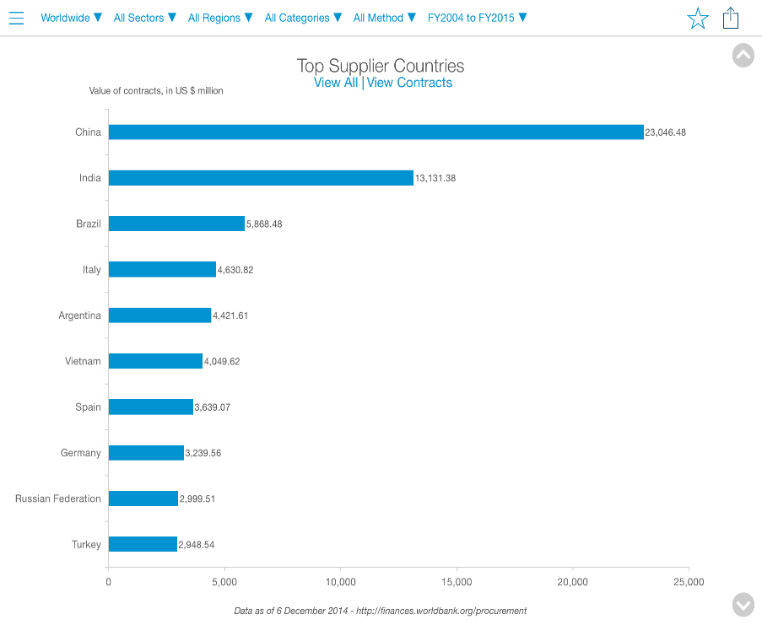
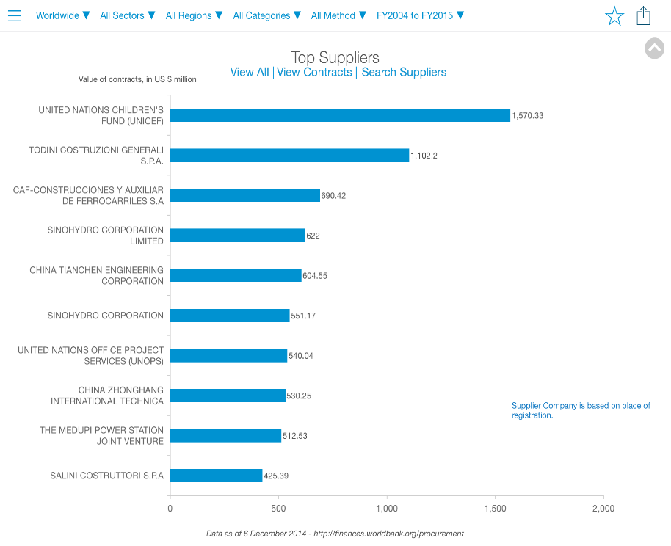
Procurement App Screen Shots

Slide 22
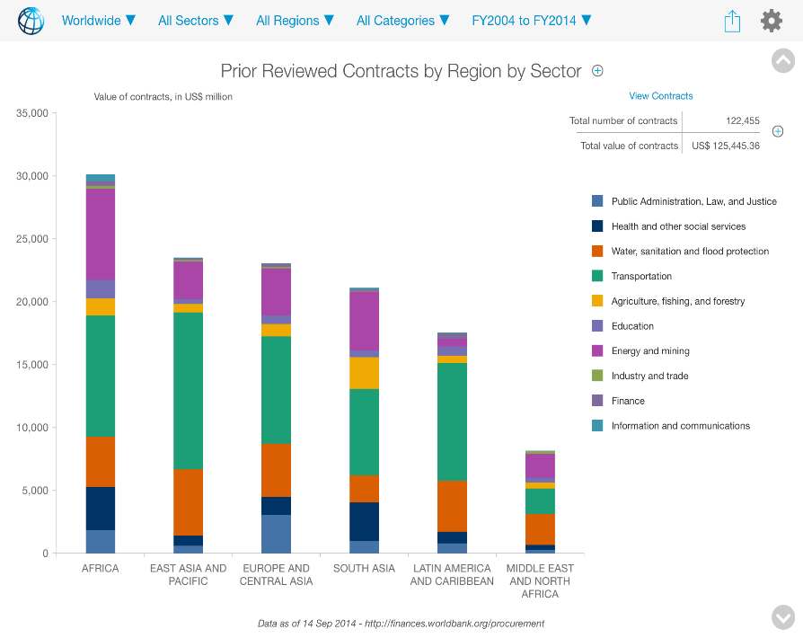
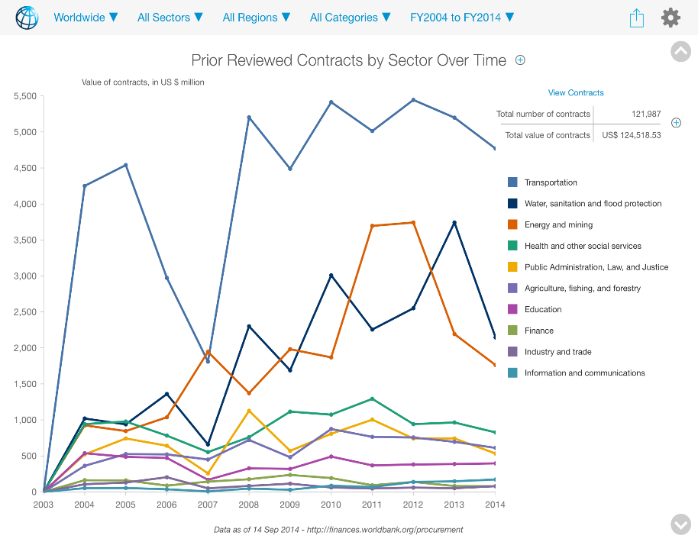
Procurement App Screen Shots

